Slide 1
Exploring the Immune Microenvironment and Prognostic Role of BTK in Lung Adenocarcinoma
A simulation study based on TCGA data mining
Presenter Name: Kindle Zhang qz2527
Advisor Name: Zhonghua Liu

Slide 2
Outline
1. Lung Adenocarcinoma(LUAD) data from TCGA and get gene expression profile (counts and tpms)
2. Perform EstimateScore and Plot Survival Curves
3. Analyze Correlation Between Clinical Features and EstimateScore
4.DEGs and Enrichment Analysis with GO and KEGG function
5. PPI and Cox regression on gene expression
6. Focus on BTK gene
7. GSEA Enrichment Analysis on BTK gene
8. CIBERSORT analysis

Slide 3
gene expressed profile
1. get LUAD data from TCGA
2. clean the data and get gene expressed profile, one for counts and one for tpms
3. Then get the ImmuneScore , StromalScore, EstimateScore(Sum of I and S) and tumor purity, according to the tpms data.
counts/tpms | TCGA-55-6971-01A | TCGA-55-6971-11A
TSPANG
TNMD
Estimate | ImmuneScore | StromalScore | EstimateScore | Tumor Purity
TCGA-55-6971-01A
TCGA-55-6971-11A

Slide 4
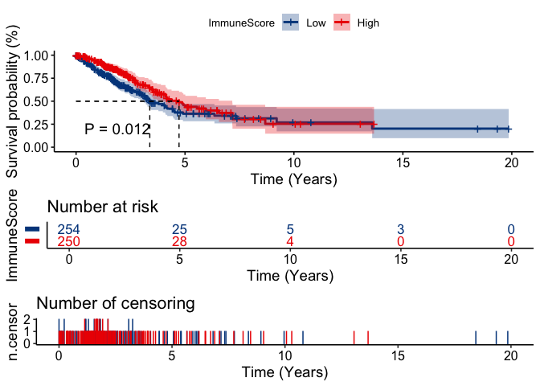
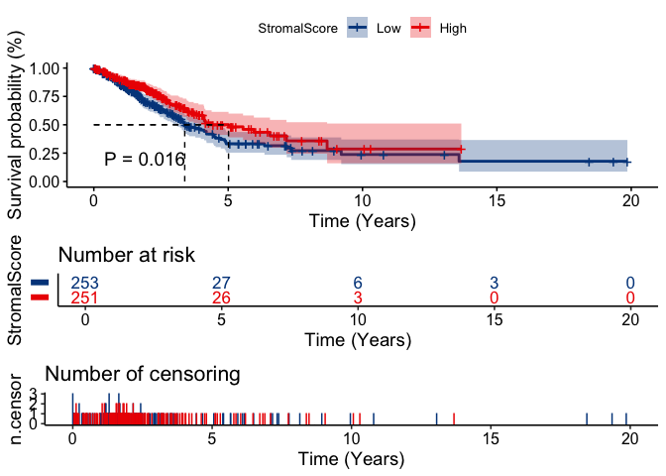

Survival curve
Combined with survival information, plot survival curve in tumor samples.
Estimate score larger, less death risk.

Slide 5
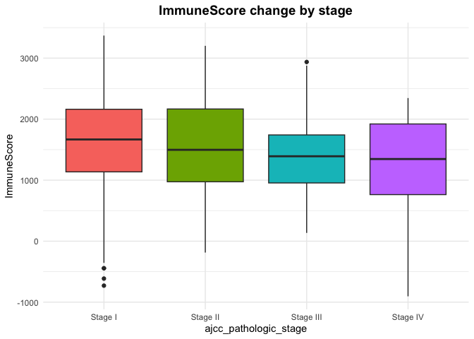
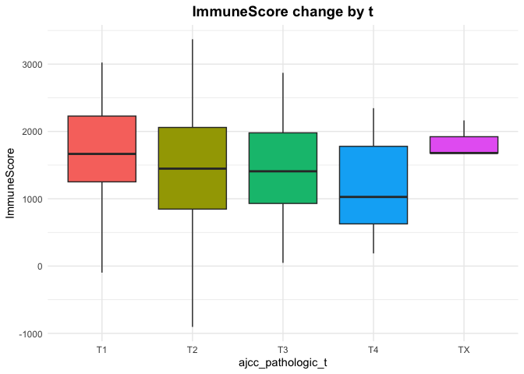
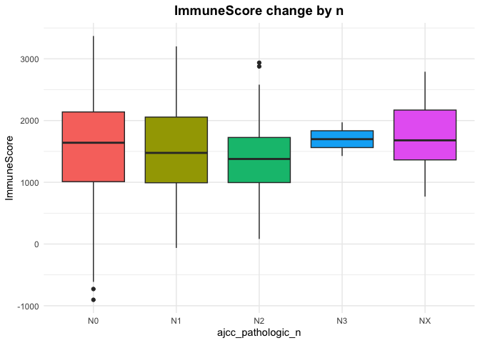
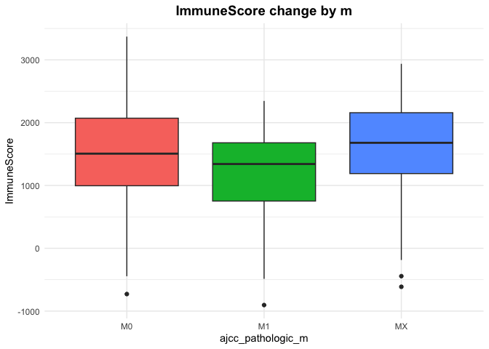
Box plot
Combined with clinical data, plot boxplot in tumor samples.
Here are the ImmuneScore performance in different clinical stages.
stage: Cancer Stage
t: Size and extent of invasion of the primary tumor
n: Regional Lymph Nodes
m: Distant Metastasis

Slide 6
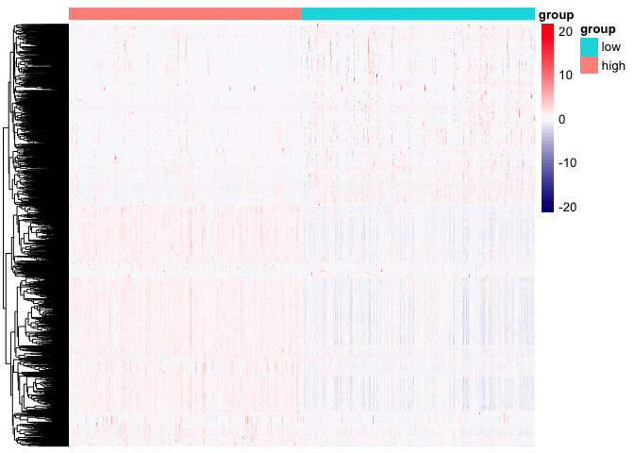
DEG
in this part, divide counts data (with tumor sample) in to two groups, one is high in StromalScore/ImmuneScore, one is low. Then make a DEG analysis.
get a heatmap like this: ImmuneSocre for example

Slide 7
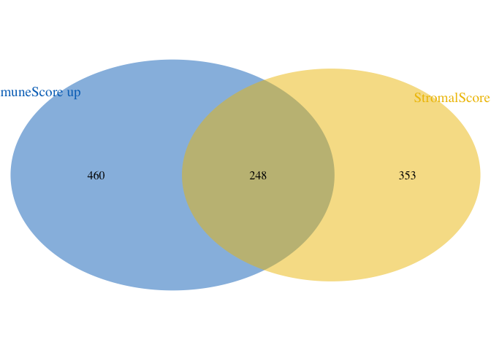
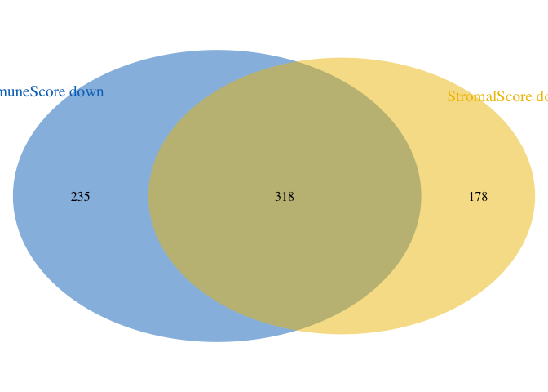
Enrichment analysis
find the intersect gene by using Venn Diagram
we get 248+318 = 566 genes that are either simultaneously upregulated in both the Immune and Stromal scores, or simultaneously downregulated in both scores.

Slide 8
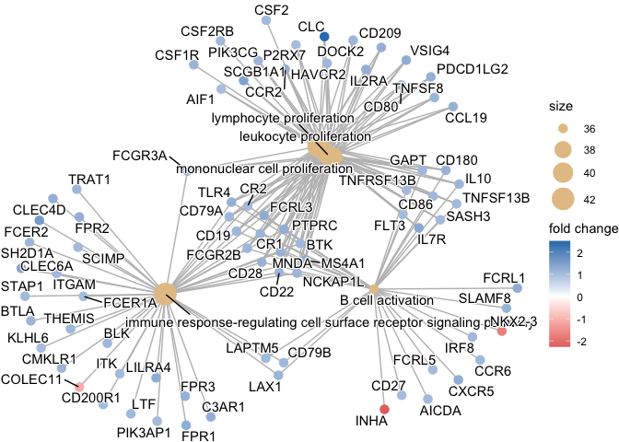
Enrichment analysis
1. GO function, according to different functions, showing like this:
2. KEGG function, according to different paths

Slide 9
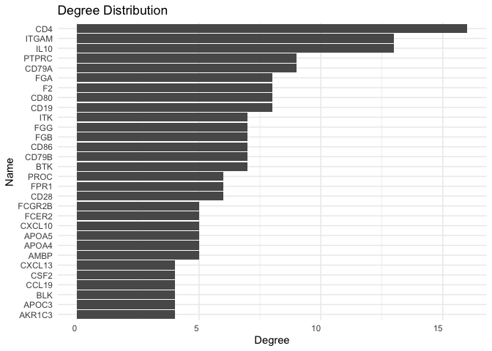
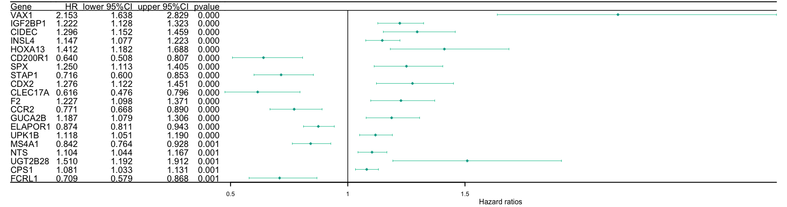
PPI analysis
make a protein and protein interaction analysis according to those 566 genes, get a table like this: CD4 is the hub gene
make a survival analysis again with 566 genes’ expression(tpms)
There’re 4 gene are both significant in PPI and COX:
"F2" "CD19" "BTK" "CD79A"

Slide 10
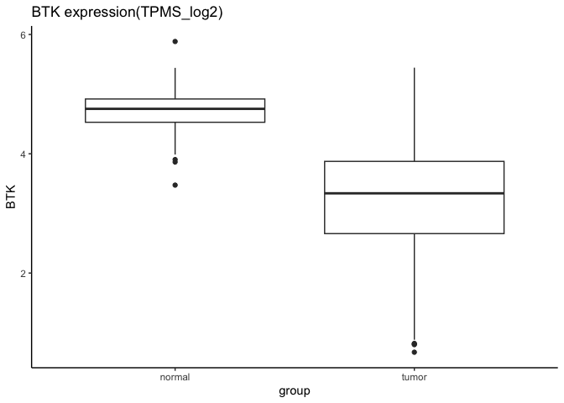
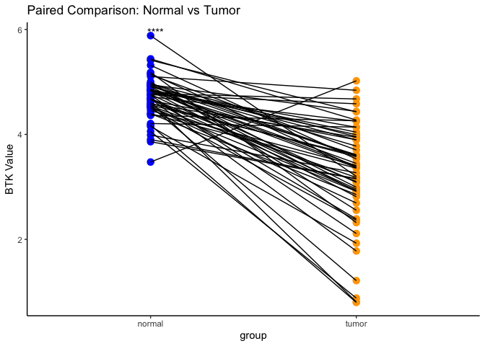
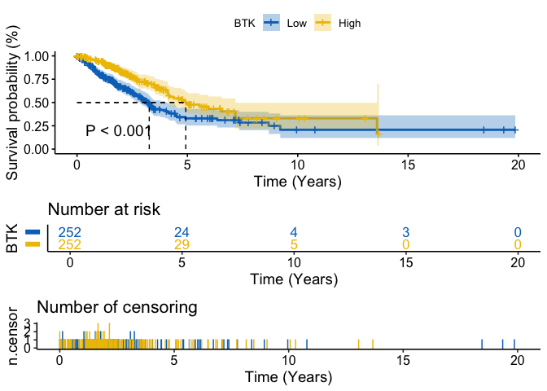
Analysis univariate gene: BTK
BTK expression in tumor and non tumor group:
box plot, paired box plot, survival curve and BTK expression along different stage.

Slide 11
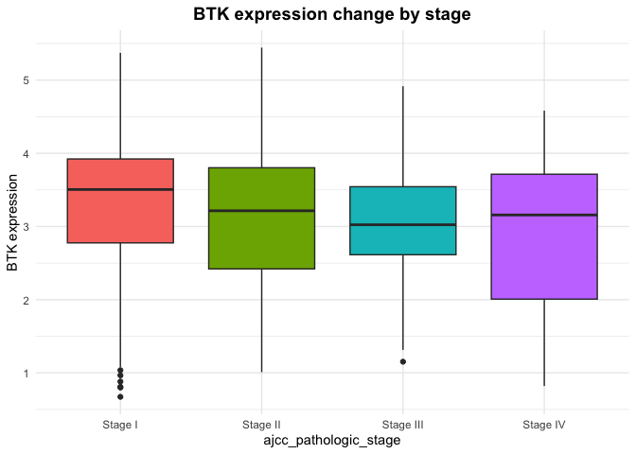
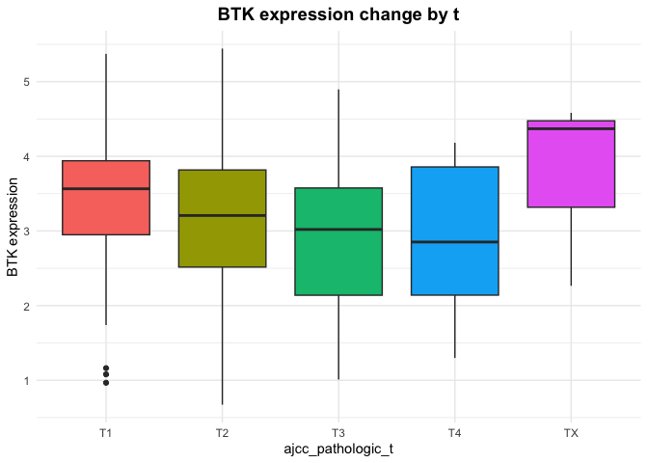
Analysis univariate gene: BTK
for example: stage and t

Slide 12
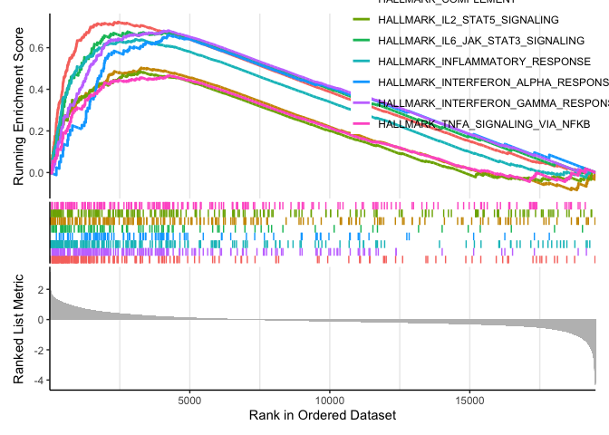
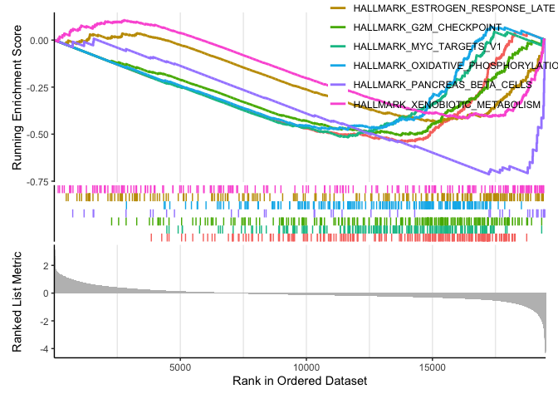
DEG again and GSEA
In tumor samples, divide sample into two groups. one is high in BTK expression, one is low. Make a DEG again.
Then make a GSEA(Gene Set Enrichment Analysis). It has advantage on GO and KEGG.
HALL set example:

Slide 13
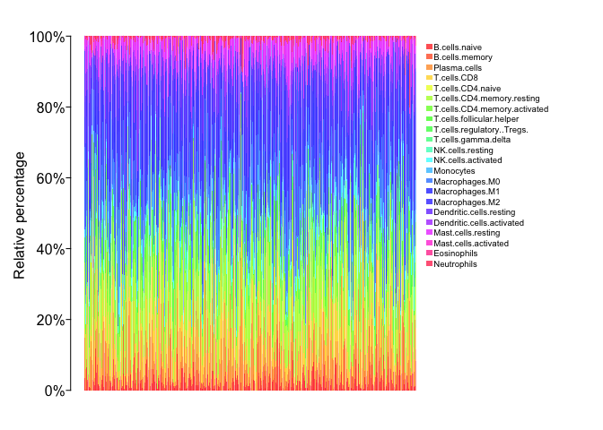
Cibersort
Cell-type Identification By Estimating Relative Subsets Of RNA Transcripts
According to tumor sample’s tpms data,we can get:
rainbow plot: Proportions of 22 immune cell types across all samples

Slide 14
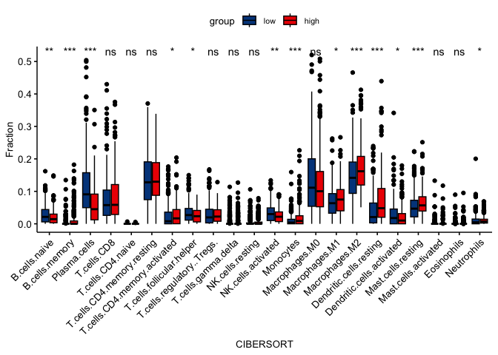
Cibersort
different test:
different immune cells performance in different BTK expression groups

Slide 15
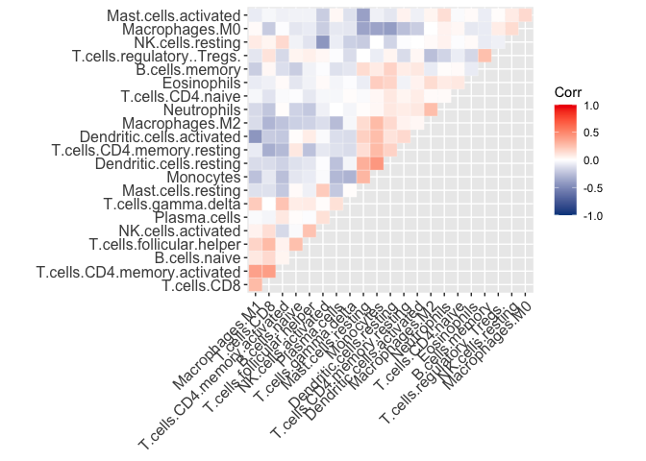
Cibersort
correlation analysis among cell types:
different immune cell proportion’s correlation plot

Slide 16
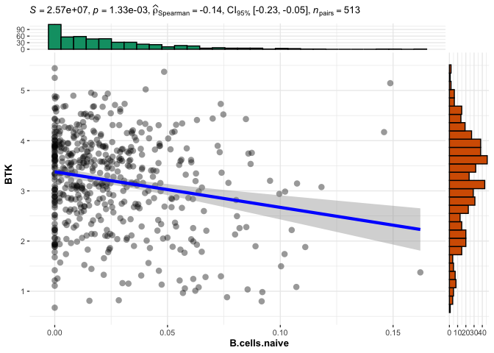
Cibersort
correlation test between BTK gene and cell types:
B.celles.naive for example:

Slide 17
Thanks for listening
my github: https://github.com/kindlezhang/bioinformatics
my email: zhangqiduo462@gmail.com

